Slide 1
“What is that in your hand?
Exodus 4

Slide 2
Arthur Godfrey Peuchen

Slide 3
“Left Behind?”

Slide 4
The Rod
Indispensable?

Slide 5
The Rod

Slide 6
The Rod
Indispensable?
Identifies
Everything he has . . ..

Slide 7
“Throw it down?!?!”
Moses—doubter or man of faith?

Slide 8
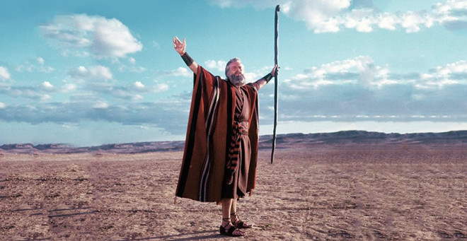
“What is in YOUR hand?”

